Slide 1
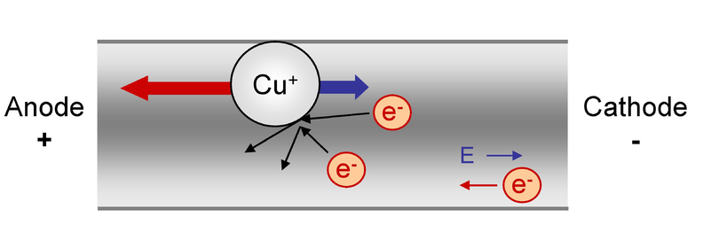

3D modeling of void formation due to electromigration in polycrystalline solders
Deepak Karunakaran
MS, Material Science and Engineering
Advisor: Dr. Yang Jiao
Dr.Nikhilesh Chawla, Dr. Yang Jiao, Dr.Jagannathan Rajagopalan

Slide 2
OUTLINE
Introduction
Motivation
Background
Related Studies
Approach/methods
Preliminary results and discussion
Implications of research
Future Work

Slide 3

Introduction
Electromigration:
Drifting electrons collide with the diffusing atoms, causing them to exchange positions with neighboring vacancies in the direction of electron flow.
Accumulation of atoms on the anode end and vacancies on the cathode end.
Will lead to hillock and void formation, which can become short and open failures, respectively.

Slide 4
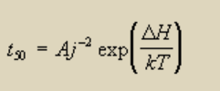
Black's Equation
t₅₀ is the median time to failure in an ensemble of samples.
j is the current density
A is a constant that needs to be empirically determined
DH is the activation energy for failure.

Slide 5
Motivation
Reliability of lead free solders is very important as we proceed to eliminate lead based solders in microelectronic packaging.
Pb- free solders possess properties less desirable for assembly and reliability: higher melting point, higher stiffness and higher surface tension.
There is established knowledge about the manufacturing techniques and reliability of Lead based solders, Sn-based solders has poor field data.
New computational technique developed can provide insights of void formation behavior.

Slide 6
Objectives of the research
Create a 3D mesoscale model representative of a polycrystalline grain structure.
Conversion to a dual phase structure of grain and grain boundary.
Finite difference scheme to identify the hot-spots.
Kinetic Monte-Carlo diffusion that leads to formation of the voids.
Study the effect of different grain parameters on the diffusion path taken by individual atoms and void characteristics of the solder interconnect.

Slide 7
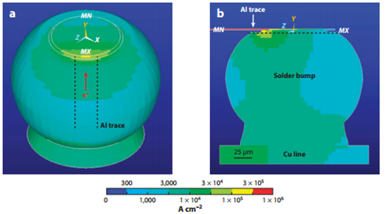
Current Crowding in Flip-Chip Solder Joint
Current enters the bump through a small area.
Peak current density - 5.1 × 10⁴ A cm ⁻²
Other end of the contact- 1.1 × 10³ A cm ⁻²
3D simulation of current-crowding effect
figure :Simulated current-density distribution over an entire solder bump when the joint is stressed at 0.6 A at 100◦C

Slide 8
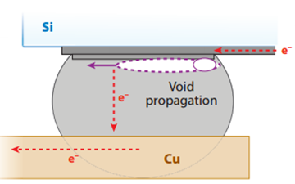
Background
Cross section of solder joint showing pancake type void formation at upper interface due to EM
How the failure occurs?
EM damage in a flip-chip solder joint occurs near the cathode contact on the chip side.
Damage begins by void formation near the entrance point of the electric current.
The void propagates into the shape of a pancake across the contact.
When the void eclipses the entire contact, the flip-chip joint fails.
Electromigration and Thermomigration in Pb-Free Flip-Chip Solder Joints Chih Chen,1, H.M. Tong,2 and K.N. Tu3

Slide 9
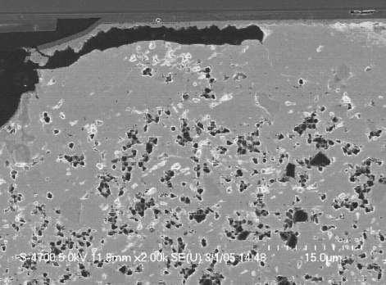
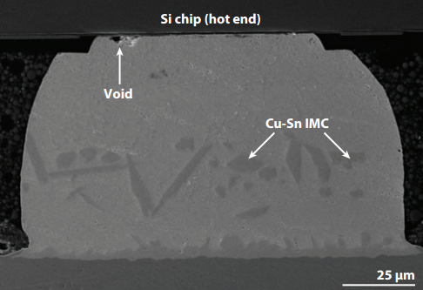
Modes of EM damage
Mode-I damage ( formation of Pancake void)
Dominated by Tin self-diffusion.
Resulting in cavitation generated at the intermetallic compound IMC/solder interface.
Has higher activation energy hence occurs at Higher Temperature.
Mode-II damage ( consumption of UBM)
Dominated by fast interstitial diffusion of Cu and Ni through Sn,
Resulting in rapid dissolution of under bump metallurgy UBM.
Has Lower activation energy and occurs at lower and higher temperature
Mode-I
Mode-II
SEM image of void formation in flip chip 95.5Sn–4.0Ag–0.5Cu
solder bump
Dissolution of Cu UBM was dissolved completely due to TM of Cu to the cold (substrate) end. IMC denotes intermetallic compound

Slide 10
Conditions for Mode I failure
High Temperature.
Sn c-axis not aligned with current direction.
Thin UBM

Slide 11
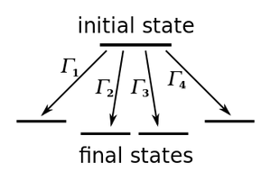
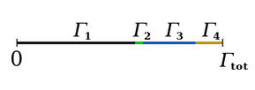
Rejection-Free Kinetic Monte Carlo
KMC method- tool to model fundamental, stochastic, physical mechanisms.
The system can jump into several states.
The transfer probability is proportional to the dot product of current vector and the jump vector.
Choice of the final state : based on random number chosen between 0 and 1;
The probability that the system jumps into state ‘i’ is proportional to ‘Γ_{i}.’

Slide 12

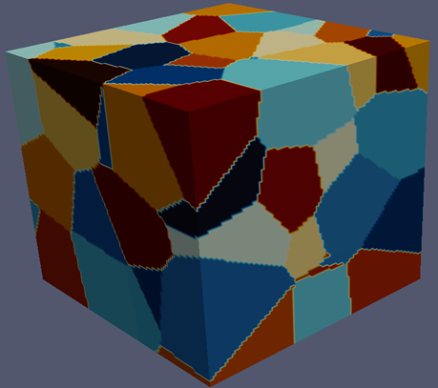
Creation of the Structure
Distribution of 100 nucleation sites in space.
Stochastic 3D micro-structure reconstruction to create a mesoscale structure.
'N' random nucleation sites .(N=100 in the figure)
Nuclei grow until they impinge.
The structure obtained was polycrystalline.

Slide 13
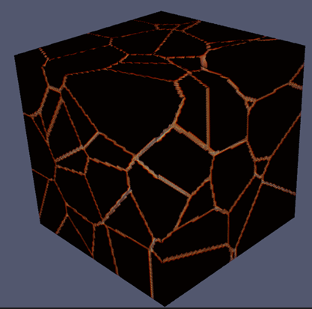
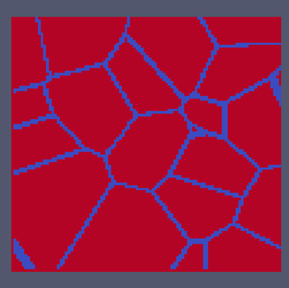
Dual Phase Microstructure
(a) (b)
The mesoscale structure was converted to a binary structure with grain and grain boundary being the two phases. a)3D structure (b)2D slice

Slide 14
Two Diffusion Approaches
VACANCY DIFFUSION
TIN DIFFUSION

Slide 15
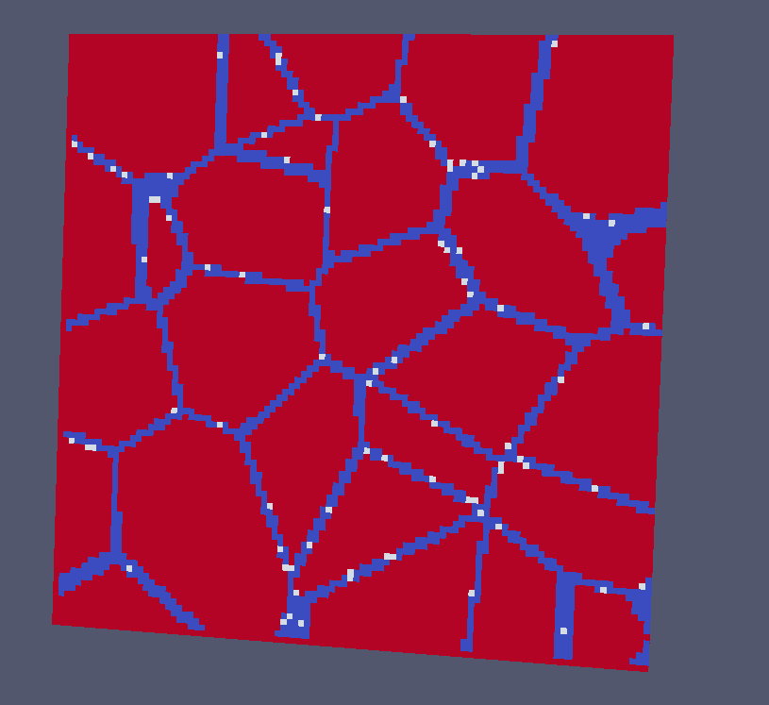
EM through Vacancy mechanism
Initial distribution of vacancies on a slice in a vacancy diffusion model
Vacancy concentration = 5 x 10⁻³ per voxel

Slide 16
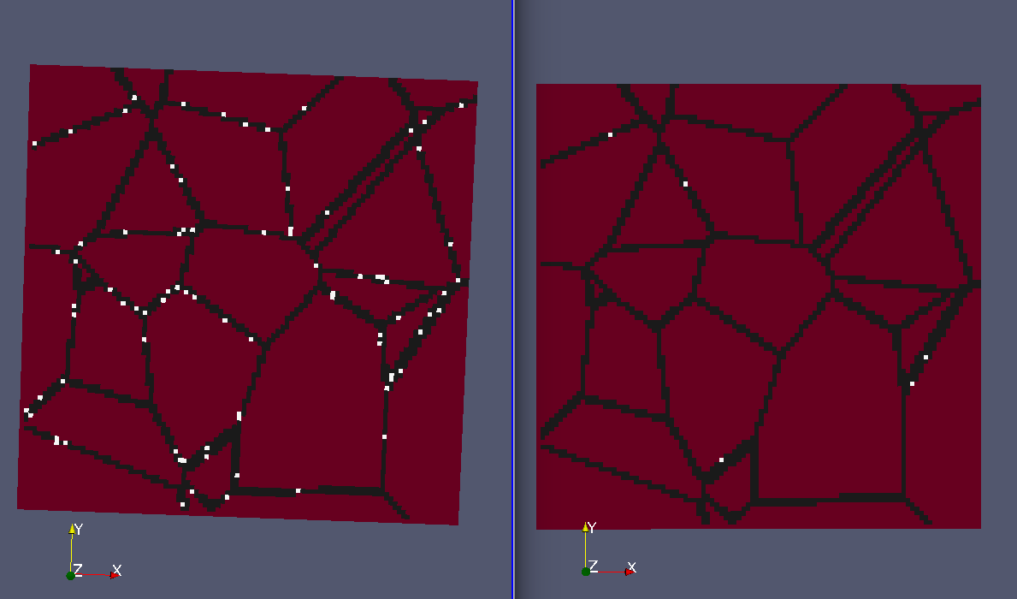
ANODE END
Initial structure After Kinetic Monte Carlo

Slide 17
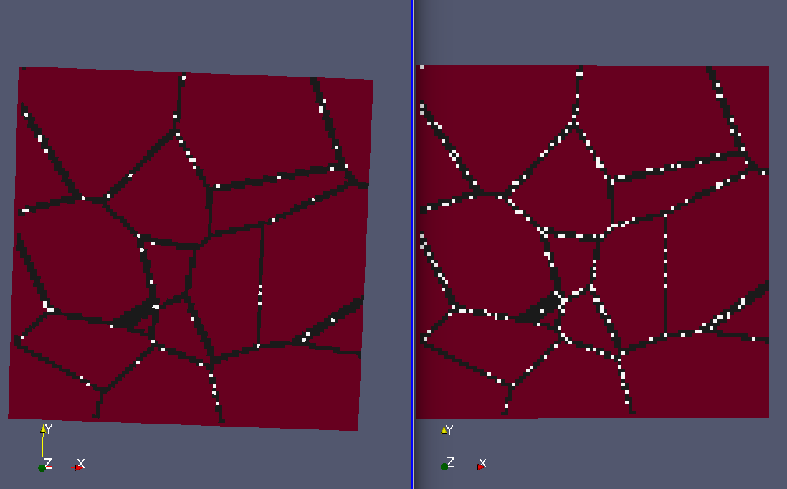
CATHODE END
Initial structure After Kinetic Monte Carlo

Slide 18
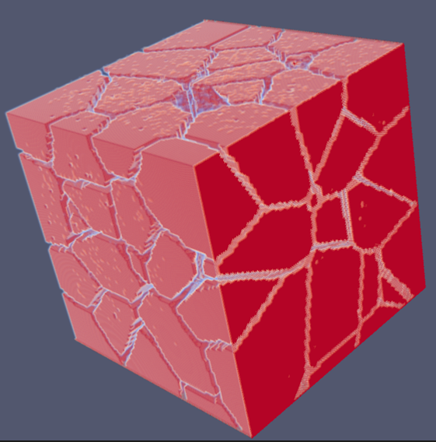
Vacancy distribution and cluster formation in 3D
Cathode end
Initial vacancy concentration=10^4 vacancies -> 1 vacancy For every 100 voxels.
Result= Void Formation on Cathode end At the end of the simulation
.
Figure shows void formation after KMC diffusion
Anode end

Slide 19
Diffusion of tin atoms
Solve for current distribution in the system using Finite Difference method.
Identify the region of maximum voltage distribution.
EM induced diffusion through Kinetic Monte Carlo simulations
Repeat above steps.
Once a void is initiated, it causes the current density to increase in the vicinity around itself because it reduces the cross sectional area of the conductor

Slide 20
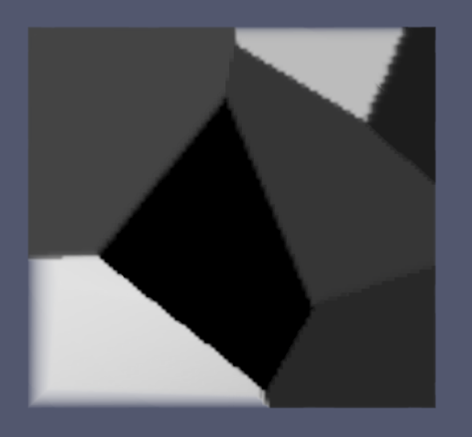
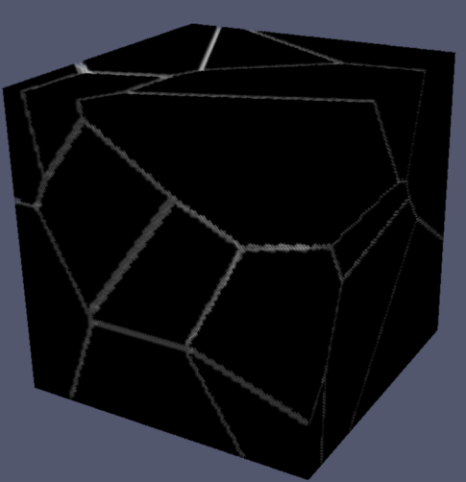
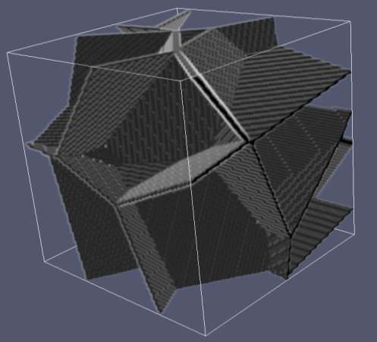
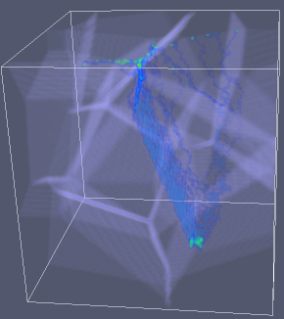
20 Grain system
Initial Structure
Dual Phase Structure
Grain Boundary
Void nucleation
Cathode end
Fig 12. Simulation results for a 20 grain system.

Slide 21
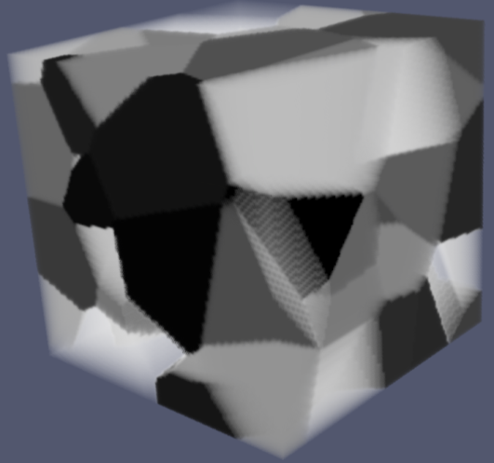
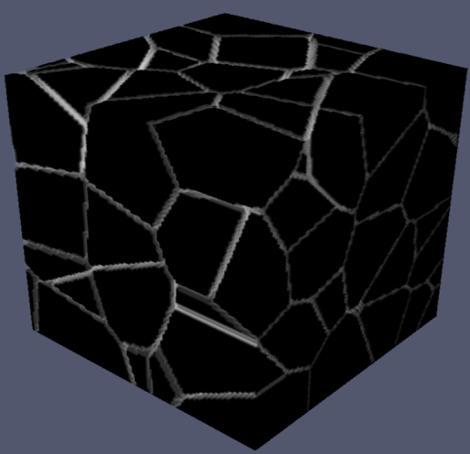
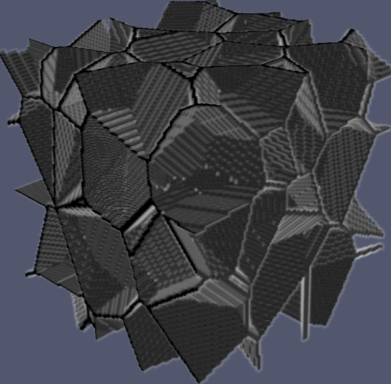
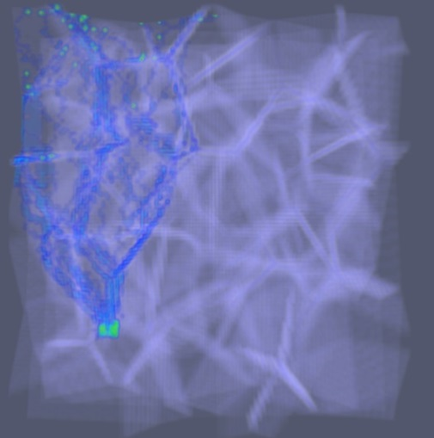
100 Grain system
Initial Structure
Dual Phase Structure
Void nucleation
Cathode end

Slide 22
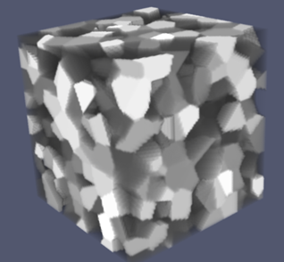
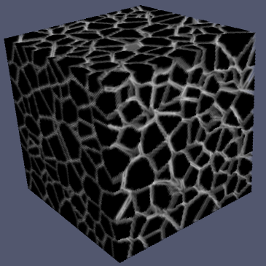
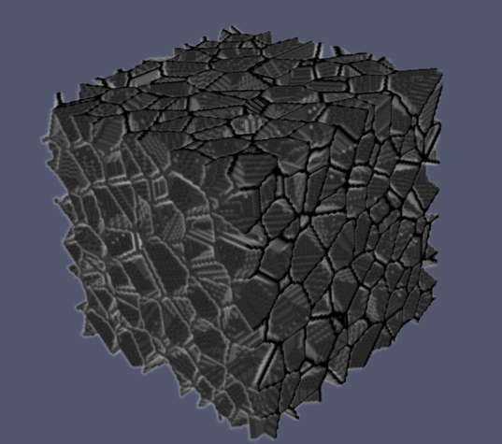
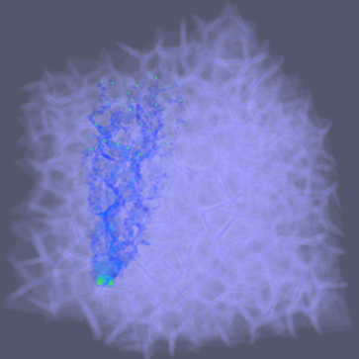
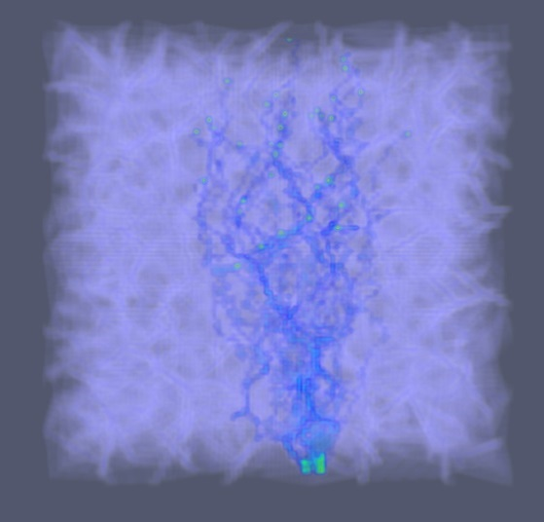
1000 Grain system
Initial Structure
Dual Phase Structure
Grain Boundary
Void nucleation
Cathode end
Fig

Slide 23
Grain Statistics
Parameter | 20 Grains | 50 Grains | 100 Grains | 500 Grains | 1000 Grains
Range of Grain Size | 4563-99452 | 6461-58206 | 1105-20453 | 222- 5348 | 97-2952
Mean Grain Size | 50000 | 20000 | 10000 | 2000 | 1000
Median Grain Size | 25028.43 | 11343.97 | 9310.5 | 944.39 | 437.15
Standard Deviation | 51618.5 | 15818.5 | 4340.9 | 1895.5 | 941
Statistics of Grain size distribution for different grain sizes. All units are in voxels. Grain Volume is 100x100x100 in all cases.

Slide 24
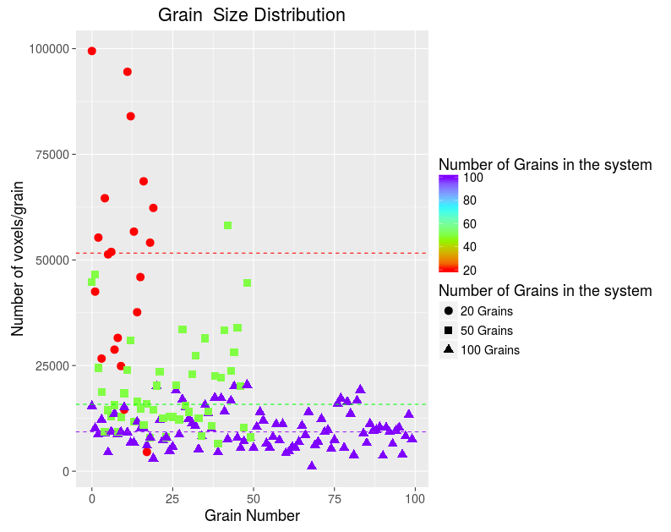
Grain Size Distribution
Figure: Distribution of 20, 50 ,100 grains created from nuclei coordinates from C++ random number generator.

Slide 25

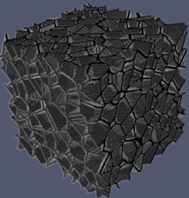
Effect of Grain size
Grain Boundary Diffusion is the primary mechanism.
Small grain size= more grain boundaries=more grain boundary diffusion.
Grain Boundary : 1)100 grain 2)1000 grain
In a 100x100x100 system.

Slide 26
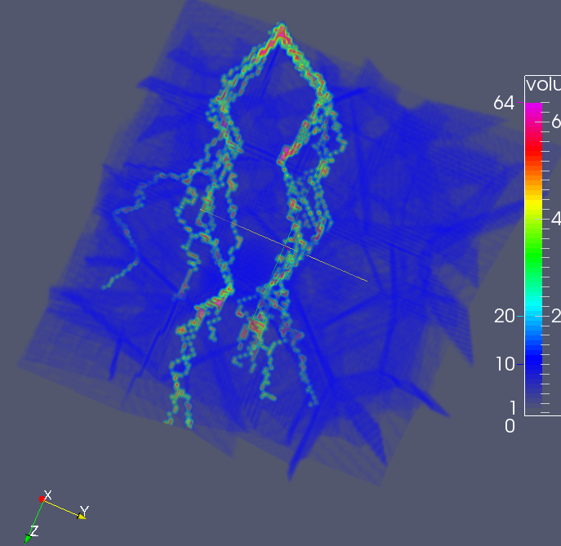
Tracking the diffusion
Void formation at cathode end
Anode end

Slide 27
Implications of research
The morphology of voids in lead free solders can be studied by varying grain size, grain orientation and other grain parameters.
The conditions for minimum electromigration damage can be determined.
These conditions can be used in practical solder design. This can help minimize electromigration damage and improve solder life.

Slide 28
Conclusions
WHAT THE MODEL CAN DO
A new approach to study EM void
formation.
Very flexible model-Explore EM varying different parameters.
Visualize the diffusion path of atoms.
Can be very powerful and effective- if more mechanisms considerations.
AREAS TO IMPROVE
Model the mode 2 failure – Role played by Copper/Nickel UBM.
Joule heating- effect of temperature
on the microstructure.
Make a dynamic microstructure instead of a static one.
Consider grain orientation/rotation of copper.

Slide 29
Future Work
Machine Learning- Use of supervised training to understand trends that favor void formation.
Train a model through supervised learning.
With predictors- Number of grains, grain size, orientation and other parameters.

Slide 30
under-bump metallization (UBM)-
A patterned, thin-film stack of material that provides 1) an electrical connection from the silicon die to a solder bump; 2) a barrier function to limit unwanted diffusion from the bump to the silicon die; and 3) a mechanical interconnection of the solder bump to the die through adhesion to the die passivation and attachment to a solder bump pad.
FLIPCHIP-This device is called a flip chip because the transistors and the very large scale integration of interconnects are on the bottom side of the chip. Thus, the chip is flipped and connected to the packaging substrate by an array of solder bumps.

Slide 31
The drifting electrons collide with the diffusing atoms, causing them to exchange positions with neighboring vacancies in the direction of electron flow. This results in the accumulation of atoms on the anode end and vacancies on the cathode end of the interconnection. Such behavior can lead to hillock and void formation, which can become short and open failures, respectively. Due to the relentless drive to miniaturize microelectronic devices, flip-chip solder joints in the packaging technology used for these devices are increasingly being scaled down. Flip-chip solder bumps with a nominal diameter of 100 μm are
being reduced to 25 μm (2)
As a result, the current density in solder
joints rises continuously with each generation, making EM a critical reliability issue in electronic packaging technology (4–7)

Slide 32
This device is called a flip chip because the transistors and the very large
scale integration of interconnects are on the bottom side of the chip. Thus, the chip is flipped and connected to the packaging substrate by an array of solder bumps.

Slide 33
The cross section of the Al line on the chip side is at least two orders of magnitude smaller than that of the solder bump.
Thus, there is a very large current-density change at the contact between the bump and the line because the same current is passing through them, resulting in current crowding.
Current crowding has two significant effects. First, there is an abrupt change in the current density in the Al interconnect where the current turns from the Al line into the solder bump.
Second, the current density in the solder bump near the entrance point is approximately one order of magnitude higher than the average current density in the middle of the bump or approximately 105 A cm−2 near the entrance when the average current density in the middle of the bump is 104 A cm−2.
This high current density in the current-crowding region causes damage in the solder joints.
EM damage in a flip-chip solder joint occurs near the cathode contact on the
chip side, i.e., the contact between the interconnect and the bump where the electrons flow into the bump (10–21). EM-induced damage begins by void formation near the entrance point of the electric current. The void propagates into the shape of a pancake across the contact. When the void eclipses the entire contact, the flip-chip joint fails.

Slide 34
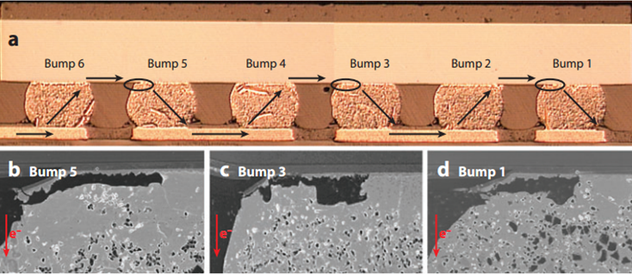
SEM Images - WHY 1,3,5?????????
(a) SEM cross-sections showing void formation(odd numbered bumps and upper left corners). Electron flow is indicated by arrows. Cathode contacts on the Si where the electron current enters the solder bump is indicated by small circles. (b) enlarged SEM images of voids in bump 5, (c) enlarged SEM images of voids in bump 3 (d) enlarged SEM images of voids in bump 5
Electromigration and Thermomigration in Pb-Free Flip-Chip Solder Joints Chih Chen,1, H.M. Tong,2 and K.N. Tu3

